Slide 2
The Role of standardization to fostering digitalization of the electricity grid
International STANDARDIZATION EVENT

Slide 3
Welcome and Introduction
Objectives of the Event

Slide 4
Objectives of the event
The main aim of the International Conference Event today is to identify critical industrial challenges and Standards needs within CROSSBOW Project framework, as well as synergies with PHOENIX Project regarding Standardization initiatives for the benefits of the European Electricity Industry.
High level representatives of CROSSBOW Consortium, European and National Institutions and Experts in the Energy Field, as well as in the Standardization Domain will provide unique and important perspectives on further developments and standardization actions.
SESION I – The objective consists in presenting the Key Role of the Standardization, identify challenges and standards needs in order to Foster the Digitalization of the Electricity Grid.
SESION II - The objective consists in presenting the projects, the products developed during implementation periods as well as identifying the industrial challenges and standardization needs for these specific products and the overall framework.

Slide 5




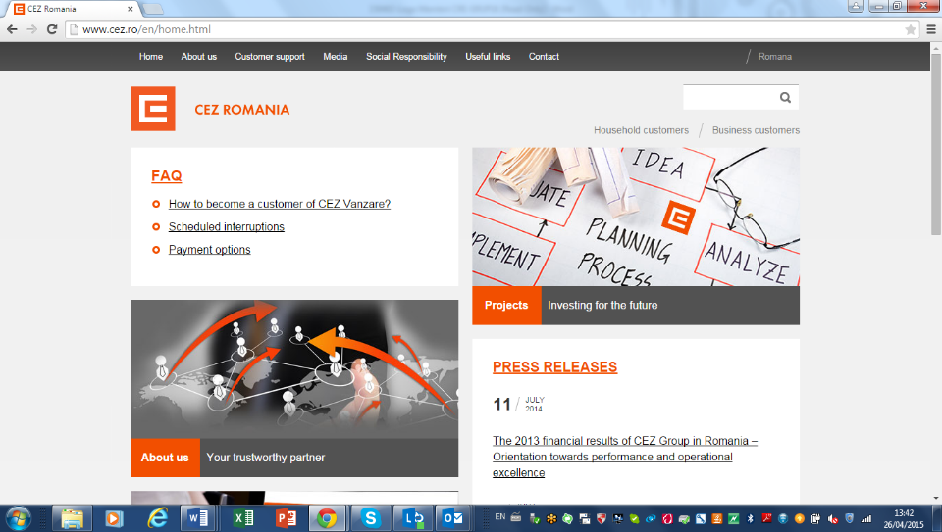











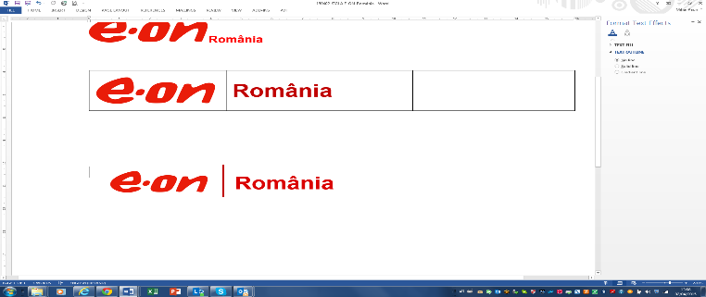
EUROPEAN PROJECTS – CRE
CRE – TOP 10 OUT OF OVER 2500 ROMANIAN ENTITIES
IN THE H2020 RESEARCH AND INNOVATION PROGRAM OF THE EUROPEAN COMMISSION
Wide scale demonstration of Integrated Solutions and business models for European smart GRID
Enabling Smart Energy as a Service via 5G Mobile Network advances
Renewables in a Stable Electric Grid
SUCCESS - Securing Critical Energy Infrastructures
SOGNO - Service Oriented Grid for the Network Of the Future
TRansmission system enhancement of regIoNal borders by means of IntellIgenT market technologY
Providing flexibility to the grid by enabling VPPs to offer both fast and slow dynamics control services
PHOENIX
CROSS BOrder management of variable renewable energies and storage units enabling a transnational Wholesale market
CYBERSEAS
3rd Party

Slide 6
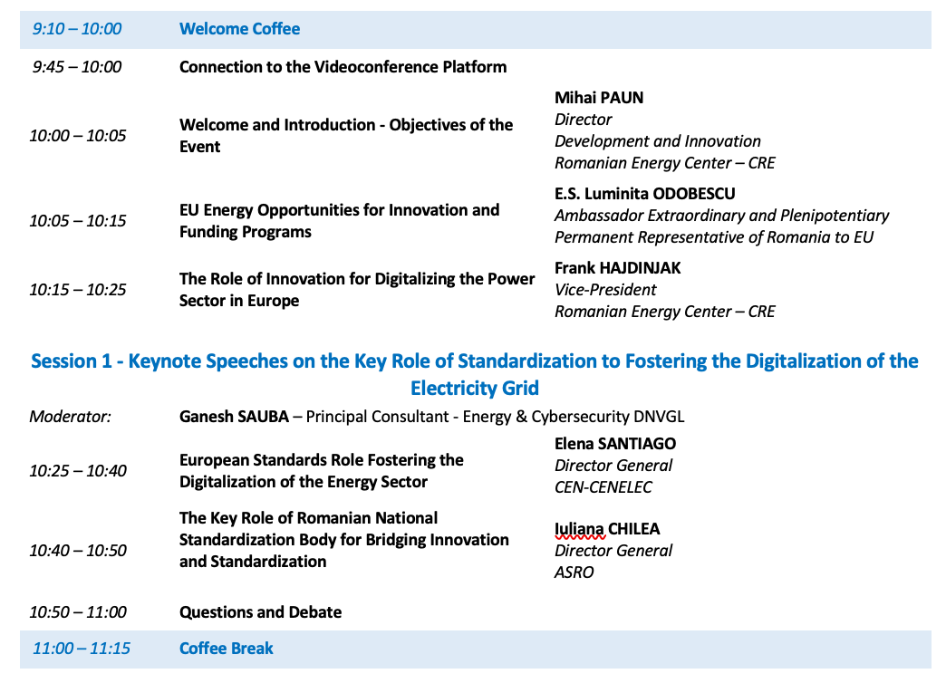
PROGRAMME
1

Slide 7
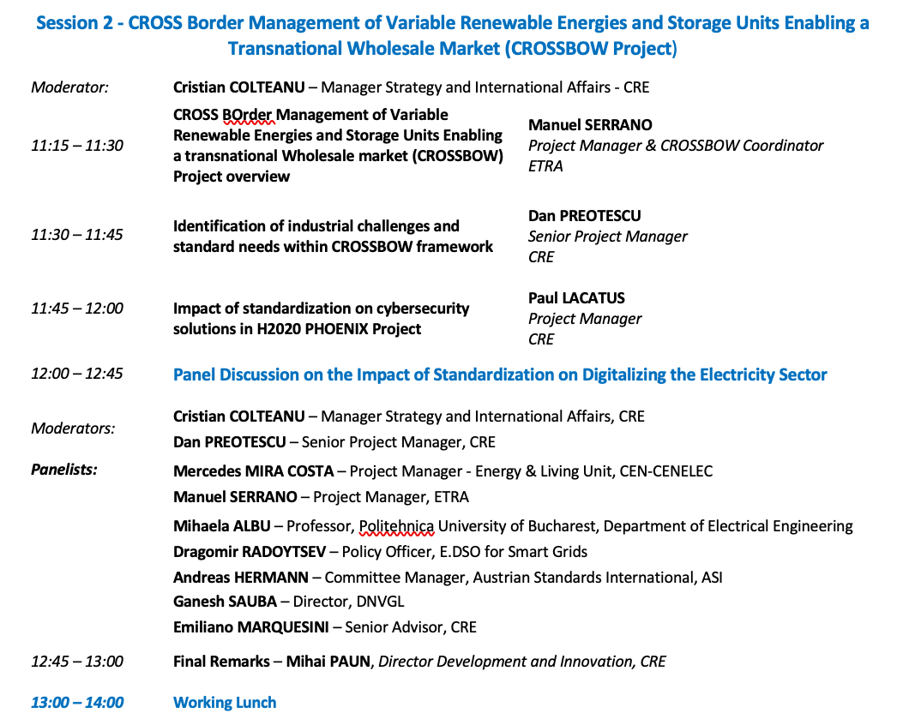
PROGRAMME
2

Slide 8
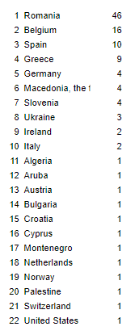
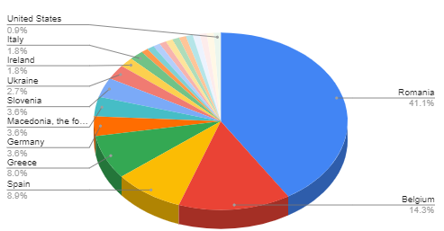
Registered participants by COUNTRY
Over 120 Registrations
22 countries

Slide 9
closing remarks
Need for deployment and investments in Digital Technologies to reach Climate Neutrality (A)
Europe needs Innovative and Affordable Solutions as there are EU Energy Opportunities for Innovation and Funding Programmes available
Continue Making the Best Use of Standardization at European Level is a MUST (ESA)
Standardization Facilitates the Dissemianation of Information for Digitalization

Slide 10
closing remarks
THANK YOU FOR ACTIVE PARTICIPATION AND INTEREST!

Slide 11

dr. Mihai PAUN
Romanian Energy Center
mihai.paun@crenerg.org

