Slide 1
Standardization impact over Cybersecurity in Phoenix Project
Ing. Paul Lacatus
EU project senior researcher
Centrul Roman al Energiei – Romanian Energy Center
Bruxelles , 03.11.2021

Slide 2
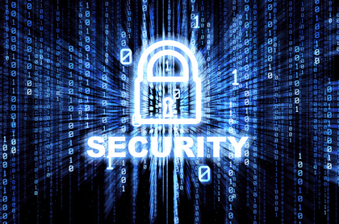
Cybersecurity
Cybersecurity is one of the most important challenges of our time.
The Information technology and communications ITC became more and more important in our life, society
Our data is managed mostly by ITC systems
Our communications , all types is done mainly by the ITC Systems
To keep all this secure, reliable and ethic is a complicated task.

Slide 3
Shaping Europe’s digital future
 | Cybersecurity Policies
New Strategy | The European Commission and the High Representative of the Union for Foreign Affairs and Security Policy presented a new EU Cybersecurity Strategy at the end of 2020.
Legislation and certification | Directive on security of network and information systems (NIS Directive) ENISA – the EU cybersecurity agency Cybersecurity Act Certification
Investment | Support for research and innovation: Horizon 2020 and cPPP; Horizon Europe Cybersecurity Competence Centre and Network; Romania
Policy guidance | The Commission's blueprint for rapid emergency response provides a plan in case of a large-scale cross-border cyber incident or crisis.
Skills and awareness | We can only ensure digital security if we have experts with the right knowledge and skills, and there are currently not enough. That is why the Commission is taking action to stimulate the development of cybersecurity skills.
Cyber community | ENISA, ISACs, JRC, CSIRTs/CERTs
Other cyber policy areas | Cybercrime, Cyber diplomacy, Defence

Slide 4

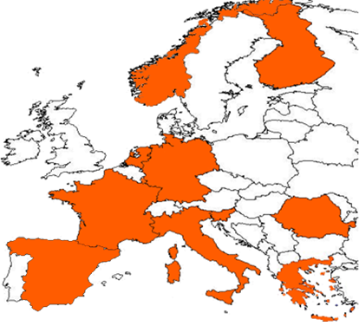


















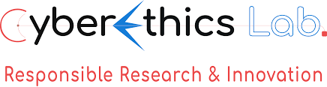



Project Overview
https://phoenix-h2020.eu/
24 partners from 11 countries:
  6 Technology Providers
  1 TSO + 1 TSO Network Operator
  4 DSOs + 2 Energy Retailers
  4 Electricity generators
  3 Equipment manufacturers
  2 End users
  1 EPES Association
  3 Specialized Technology SMEs
  2 Leading Research Institutions
  CERT-RO is indirectly involved (in support of NIS Directive)

Slide 5
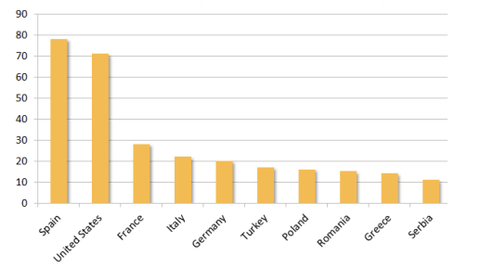
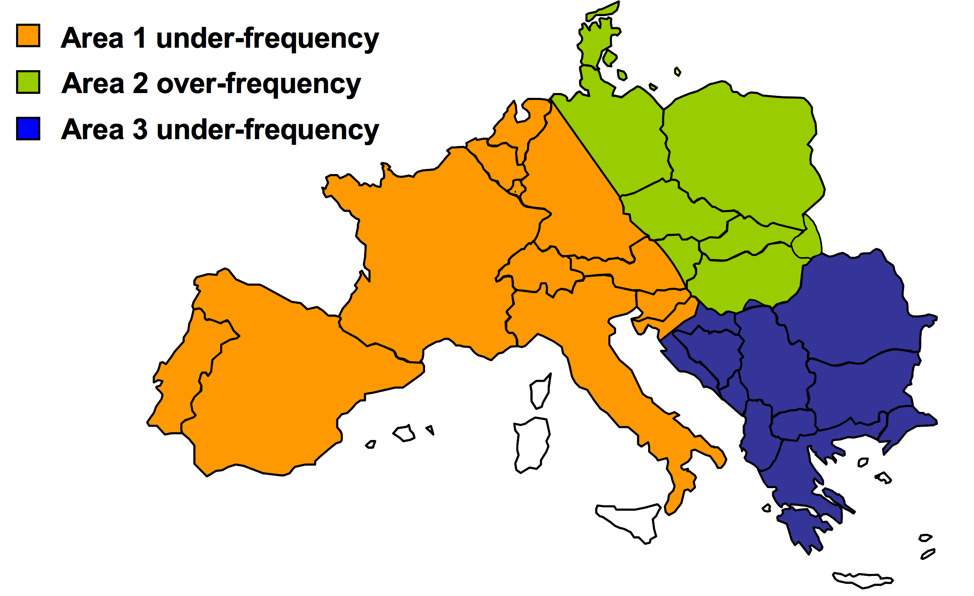
PHOENIX Challenge
EPES is considered among the most complex Cyber-Physical system with huge (cascading) effects to other critical infrastructures (i.e. water supply, communications, transportation, industry, finance)
EPES has already experienced significant complex cyber-attacks.
Incidents of Cyber Attacks in US
(source: US Department for Homeland Security)
European blackout due to human error (Nov. 2006)
Dragonfly EPES attacks since 2014

Slide 6
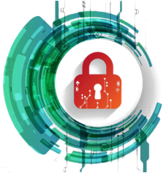
Vision and Scope
Strengthen EPES cybersecurity preparedness
  Cybersecurity Preparedness/Privacy by Design & Cybersecurity by Innovation
Coordinate EPES cyber incident discovery, response and recovery
  Facilitate cyber threat intelligence (CTI) sharing among authorized
  utilities, CERTs, CSIRTs, ISACs, NRAs and the NIS cooperation group
  Accelerate Directive on Security of Network and Information Systems
Accelerate research and innovation in EPES cybersecurity
  DevSecOps mechanism to ensure code security during its lifetime
  Applied privacy preserving (federated) Machine Learning
  Definition of certification methodologies and procedures

Slide 7


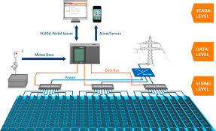
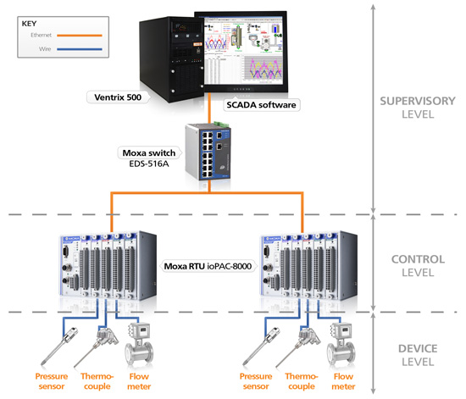
PHOENIX Simplified Architecture
Pan-European EPES Incidents’ Information Sharing Platform
PHOENIX
Incidents Information Sharing
Incident Mitigation & Enforcement Countermeasures (IMEC)
Situation Awareness, Perception & Comprehension (SAPC)
Privacy Protection Enforcement (PPE)
Incidents Mitigation Decision Support System
Threat detection Co-simulator
Offline/Online
ML Framework
Stochastic Modelling
Advanced Consent
PHOENIX EPES
Awareness &
Enforcement
Cyber countermeasure
Enforcement
Data Analytics &
Patterns Extraction
Reputation Mechanism
& Mutual Auditability
Countermeasures
implementation
Events & Threats Patterns
(Historical /real-time)
logs & Data
GDPR compliance
implementation
Trusted Inter-ledger Transactions Layer
SDN & 5G Networks (when available)
Cloud based storage of threat, patterns, countermeasures & personal data
Ethereum and/or Quorum
Secure & Persistent
Communications
(SPC)
DLT storage of critical
logs & transactions
Secure Cloud
Legacy ICS Equipment &
Application Platforms
(e.g. SCADA, PLC, AMI, CIS)
USG
USG
Secure API
New Generation
ICS Equipment
(e.g. SCADA, PLC, PMU)

Slide 8


PHOENIX achievements
Analysis & Design
1. Risk Identification & Classification
Risk identification
Effective cyber incident & attack detection, categorization, prioritization and mitigation
Focus on high availability (resilience, survivability), fast recovery and data privacy.
    Analysis of all aspects of Interdependent cyber-human EPES Protection
    Designed a risk assessment framework to classify the EPES into secure tiers
    Security / Privacy / Survivability by design principles identified and adopted
    Privacy, data Protection, Ethics, Security and Societal (PRESS) framework

Slide 9






PHOENIX achievements
Prototypes
Secure, Persistent Communications | EPES Situation Awareness, Perception and Comprehension | Privacy Protection Enforcement
Incidents Mitigation and Enforcement of Countermeasures | Incidents’ Information Sharing Platform | Integration Security and Privacy as a Service

Slide 10
PHOENIX Large Scale Pilots

Slide 11
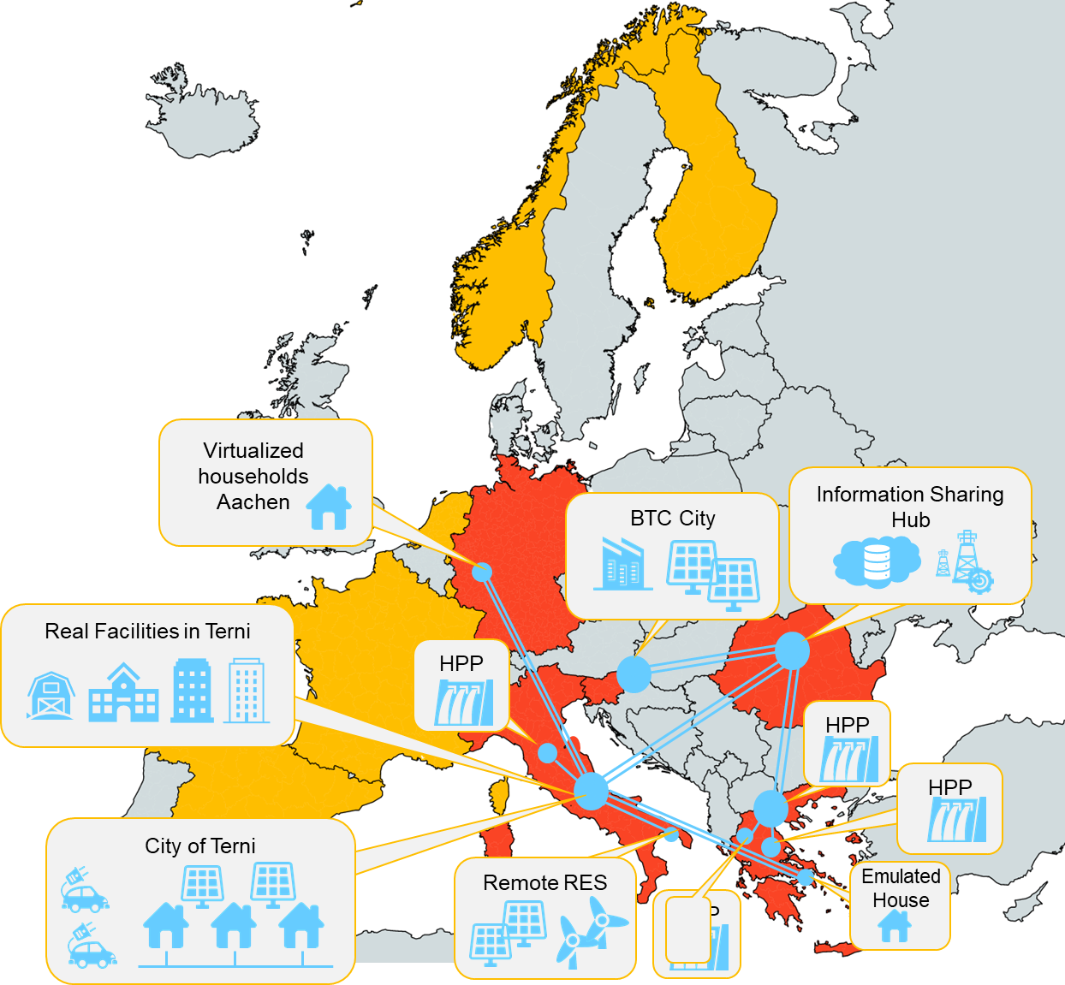
Overview
5 diverse Large-Scale Pilots
  Multi-utility/Multi-owner RES cyberthreats and data breach detection (Italy)
  National-wide cooperative remotely controlled HPP (Greece)
  Collaborative Microgrid-enabled cyber risks mitigation (Slovenia)
  Collaborative / DSO flexibility vs cybersecurity and privacy (Italy, Germany, Greece)
  National vs Pan-European cooperative cyber threat information sharing (Romania)

Slide 12

Cybersecurity and standardization
The goal of cybersecurity standards is to improve the security of information technology (IT) systems, networks, and critical infrastructures
Cybersecurity standards are collections of best practice, created by experts to protect organisations from cyber threats.
Cybersecurity standards and frameworks are generally applicable to all organizations, regardless of their size, industry or sector.
A conference about Cybersecurity and standardization was held by ENISA this year in February

Slide 13
Cybersecurity and Certification
Certification is another layer of standardization in Cybersecurity
Rampant cyber-attacks on organizations of every size and scale throughout the world indicate that cybersecurity is one of the most critical factors that businesses need to incorporate in their operational strategy.
Certifications allows to verify the capacity of a cybersystem to align with cybersecurity standards and be resilient to cyberattacks

Slide 14
Thank you
Eng. Paul Lacatus
Romanian Energy Center
Centrul Roman al Energiei
Paul.Lacatus@crenerg.org

