Slide 1


























Coordinator:
Participants:
CROSS BOrder management of variable renewable energies and storage units enabling a transnational Wholesale market
This project has received funding from the european union's horizon 2020 research and innovation programme under grant agreement n˚ 773430

Slide 2
CROSS BOrder management of variable renewable energies and storage units enabling a transnational Wholesale market
PROJECT OVERVIEW
Introduction
2.11.2021
ESTEBAN PASTOR, ETRA

Slide 3
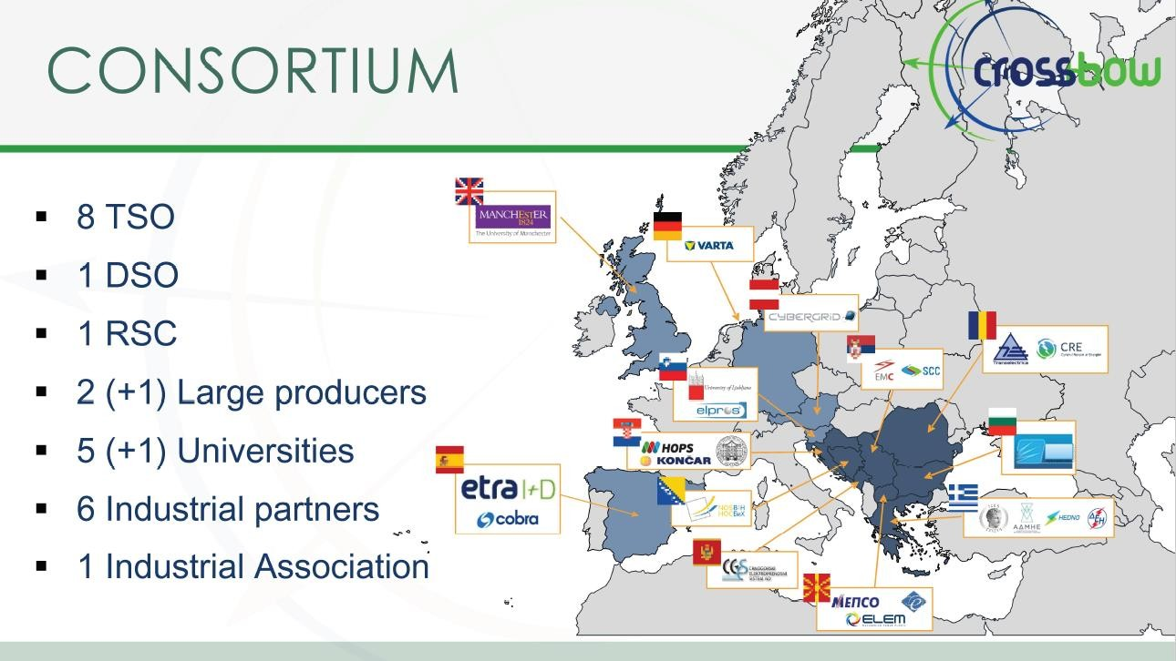
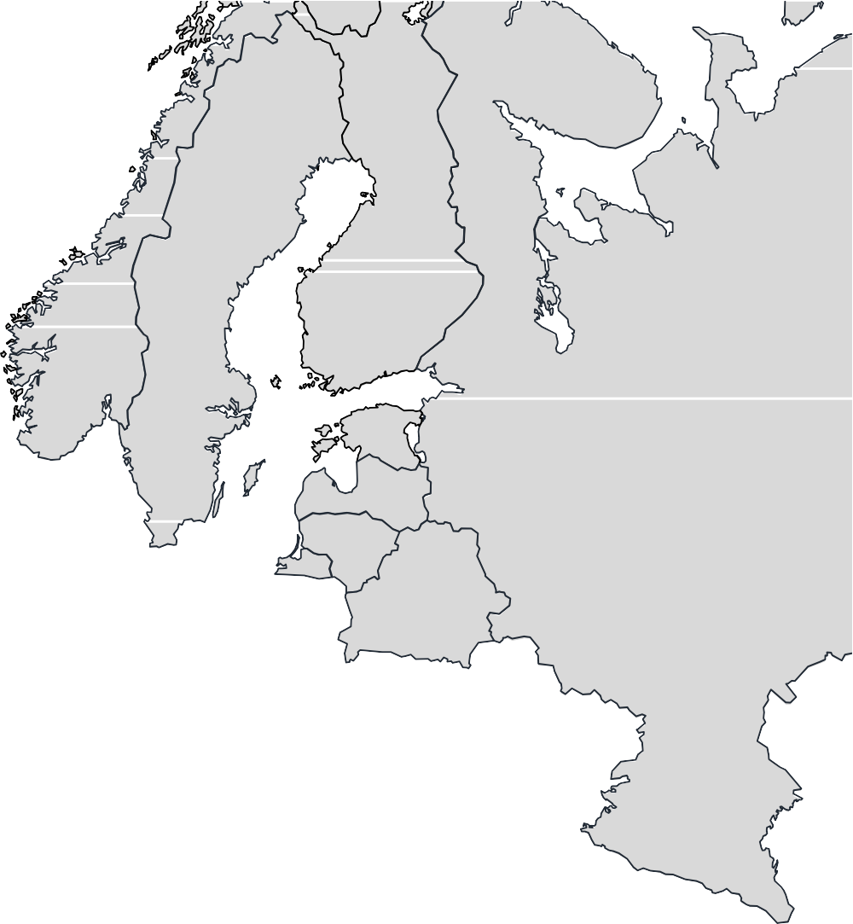


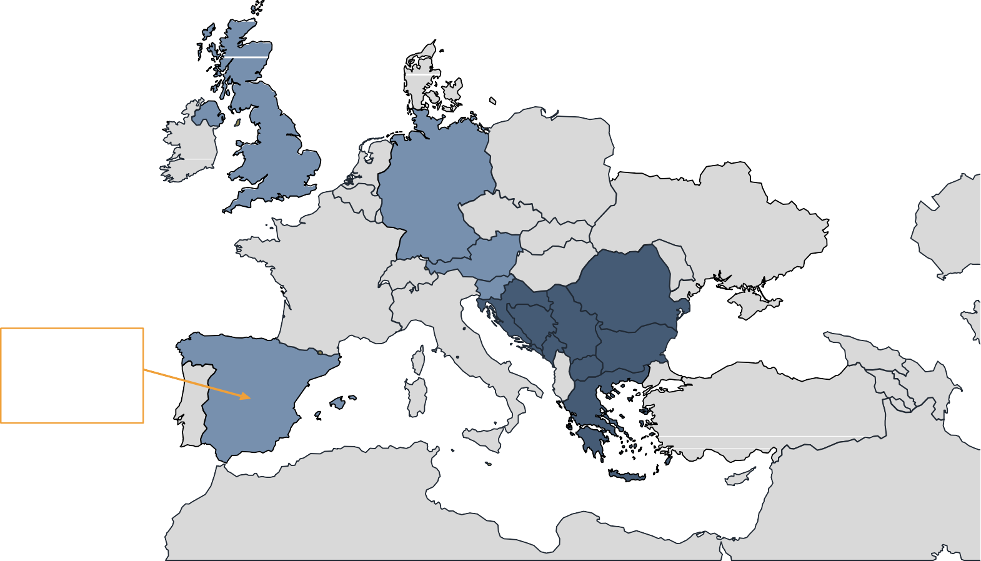























CONSORTIUM
8 TSO
1 DSO
1 RSC
2 (+1) Large producers
5 (+1) Universities
6 Industrial partners
1 Industrial Association

Slide 4



PROJECT AT A GLANCE
CROSSBOW ROC balancing cockpit CROSSBOW RES regional Coordination Centre
CROSSBOW hybrid RES dispatchable unit CROSSBOW Regional Storage Coordination Centre CROSSBOW Virtual Storage Plants
CROSSBOW WAMAS system
CROSSBOW Regional DSM integration platform
3197 PMs
November 2017
Starting date
48 months
Duration
H2020
Topic
9 Products
22 M€
Budget
CROSSBOW Wholesale and Ancillary Market toolset CROSSBOW Cooperative Owned Flexibility Assets Platform
Austria
FYROM
Montenegro
Slovenia Croatia
UK
Bosnia and Herzegovina
Serbia
Bulgaria Germany
LCE-04-2017: Demonstration of system integration with smart transmission grid and storage technologies with increasing share of renewable
HLU1 REGIONAL OPERATION CENTRE HLU2 CROSS-BORDER RES MANAGEMENT
HLU3 CROSS-BORDER STORAGE OF RES PRODUCTION/OUTPUT
HLU4 DISTRIBUTED STORAGE FOR SYSTEM STABILITY AND ENERGY QUALITY CONTROL
HLU5 VIRTUAL STORAGE PLANTS
HLU6 TRANSNATIONAL DEMAND SIDE MANAGEMENT HLU7 HYBRID RES DISPATCHABLE PLANTS
HLU8 COOPERATIVE OWNERSHIP OF FLEXIBILITY ASSETS
13
Countries
power transmission technologies and management of large scale RES generation
9 Pilot Clusters (HLUs)
wholesale market
Large scale storage
Spain
Romania
Communication / ICT technologies / control tools
HLU9 TRANSNATIONAL ANCILLARY AND WHOLESALE MARKET
Greece

Slide 5
STRATEGIC GOAL
CROSSBOW proposes the shared use of resources to foster cross-border management of variable renewable energies and storage units, enabling a higher penetration of clean energies whilst reducing network operational costs and improving economic benefits of RES and storage units.

Slide 6
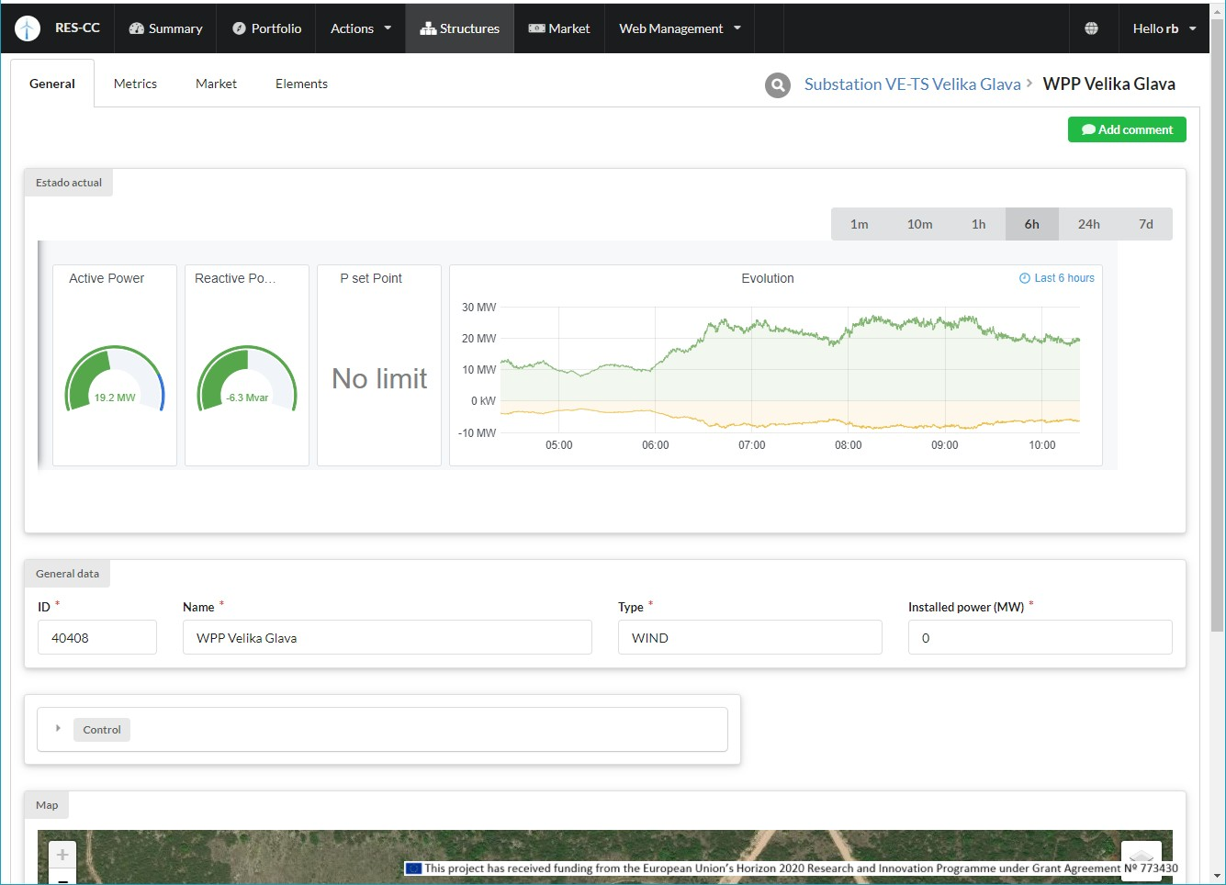
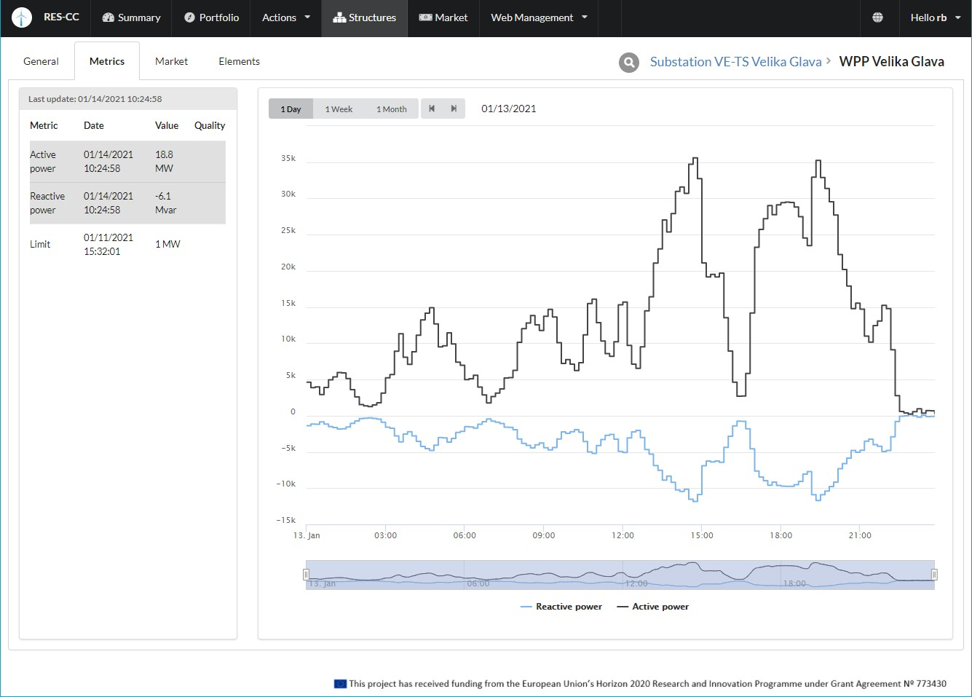
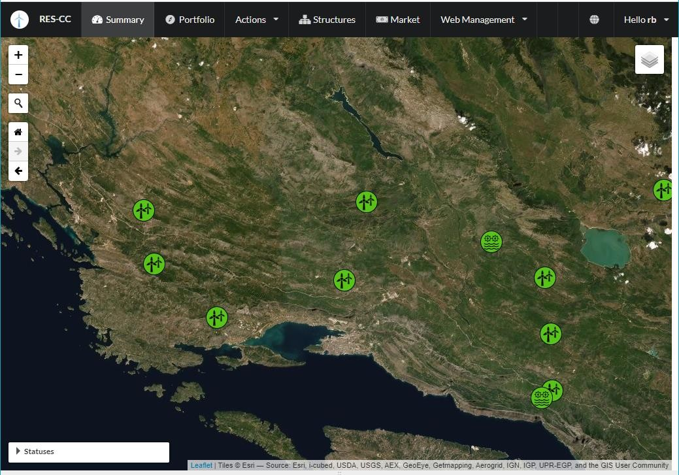
RES-CC FEATURES
User interface prepared for monitoring RES units portfolio
  Static information of RES units at the region obtained
  Integration of real time data from some (most) assets in the region

Slide 7
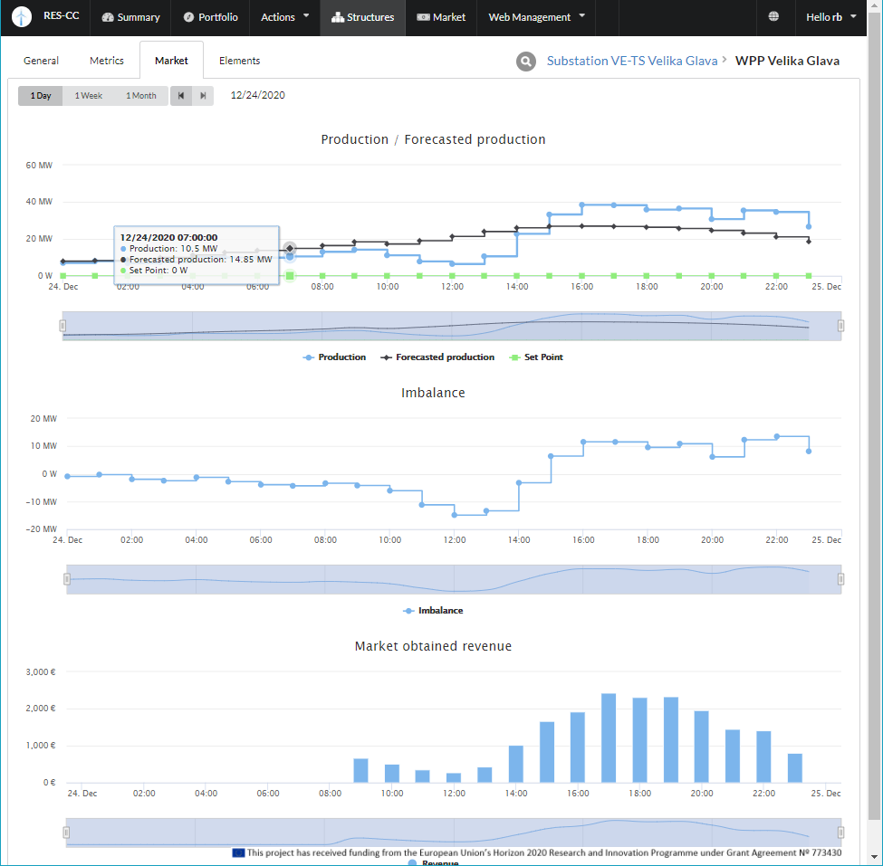
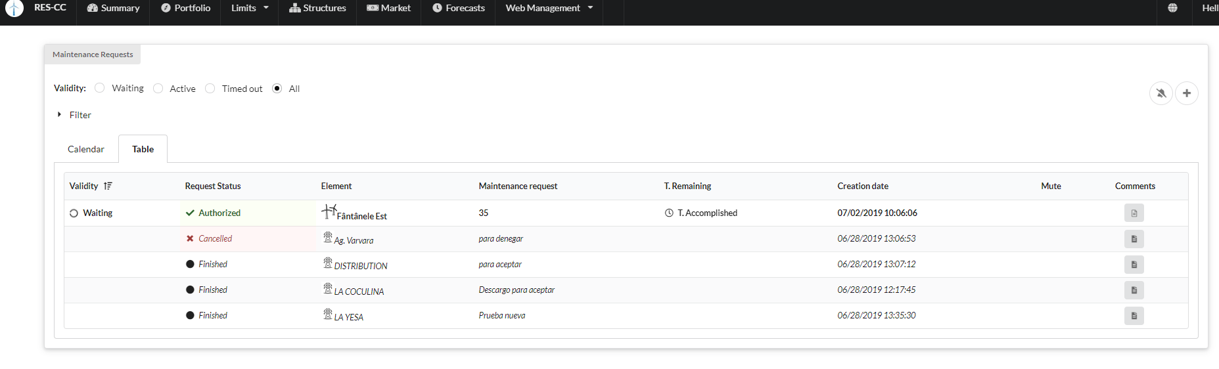
RES-CC FEATURES
Generation forecast are periodically generated for most of the RES assets in the region
Support for RES assets maintenance management

Slide 8
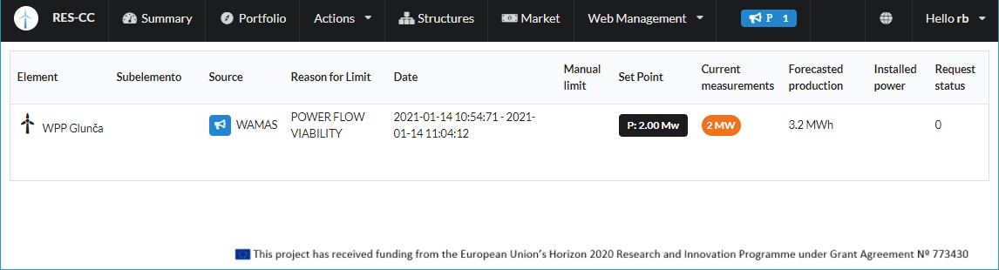
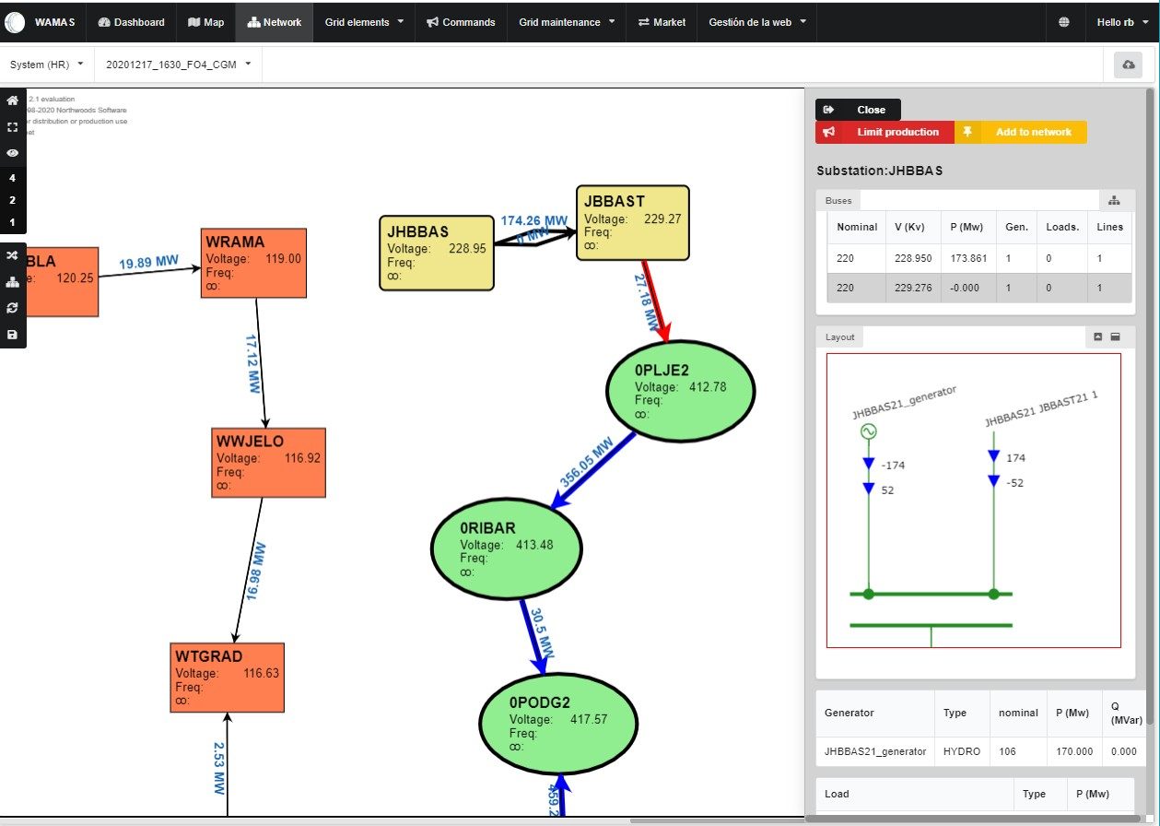
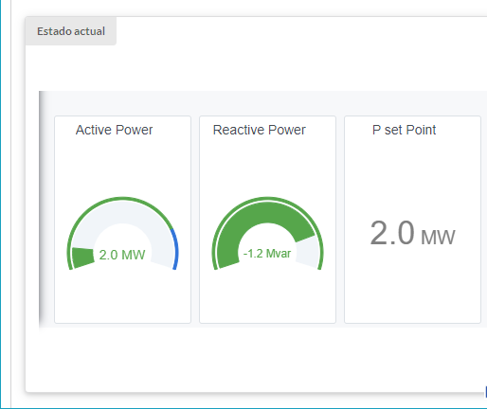
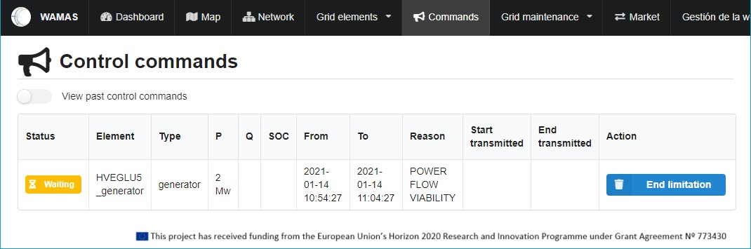
RES-CC FEATURES
Integration with WAMAS

Slide 9
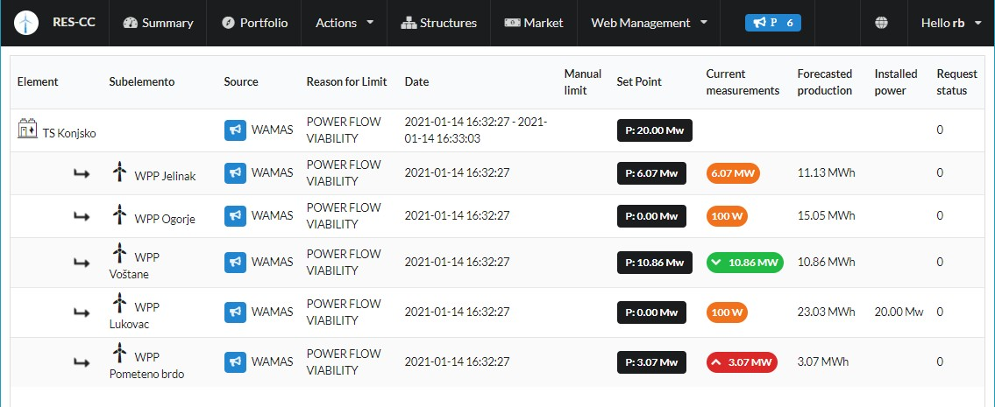
RES-CC FEATURES
Curtailment distribution.
  Rule based
  Market based

Slide 10
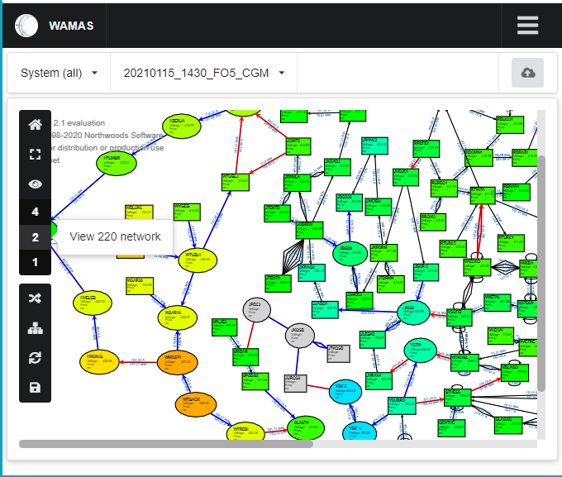
WAMAS TOOL GUI FEATURES
Grid map visualization options
  Real time or forecasted status
  Diagram colouring based on voltage levels
  Possibility of selecting visualization of 400Kv, 220Kv and/or 110Kv

Slide 11
WAMAS TOOL BACKOFFICE SERVICES
CGM models compiled and merged by SCC are received periodically
Data is imported using RTE power system libraries (PowSyBL). CGMES and UCTE-DEF formats are supported
Power flows are calculated and based on them:
  Security analysis is performed
  N-1 Contingency analysis is also carried out

Slide 12

Clean energy across Europe
FOLLOW US ON TWITTER: @CROSSBOW_H2020
For more information visit: crossbowproject.eu

