Slide 1
The Key Role of Romanian National
Standardization Body for Bridging Innovation and Standardization

Slide 2





ASRO is member of:
International Electrotechnical Commission –
since 1927
International Organization for Standardization – since 1950
European Committee for Standardization –
since 2006
European Committee for Electrotechnical Standardization – since 2006
European Telecommunications Standards Institute – observer member since 1991
2
Notes:
Romanian Standards Association - ASRO is the National Standardization Body recognized by Government Decision, notified to the European Commission and published in the Official Journal of the European Union. ASRO represents Romania as member in the International Electrotechnical Commission (since 1927) and International Organization for Standardization (since 1950) and in the European standardisation organizations CEN, CENELEC and ETSI.

Slide 3
Participation in projects – ASRO experience -
Cooperation inside European Standardization communities: BRIDGIT Projects, SABE, Project 4: Open-Source solutions
Cooperation on Horizon 2020/Horizon Europe: project STRATEGY, in implementation, proposals of projects in different area (ex.: 4 proposals in 2020, 6 proposals in 2021)
Cooperation for education in standardization: ERASMUS+ Projects (STUNED in implementation, 2 proposals in 2021)
Cooperation for twinning in standardization projects: Moldova, Ukraine, Georgia
Cooperation for TAIEX projects: Moldova, Azerbaijan, Ukraine, Siria, Tadjikistan

Slide 4
STARGRID project - FP7
Aim - provision of a comprehensive analysis of Smart Grid standardisation efforts, including new industry developments and initiatives.
5 partners: Fraunhofer Institute for Wind Energy and Energy System Technology, European Distributed Energy Resources Laboratories (DERlab), Ricerca sul Sistema Energetico SpA – RSE, TECNALIA Research & Innovation and ASRO
STANDARDS ARE SUITABLE TOOLS FOR THE INTERFACES OF Smart Grids
Several gaps have been identified in the analysed standards in relation to technical regulation rules for DER integration, smart metering infrastructure and Cyber security, using a systemic approach based on use cases within STARGRID Project. For example, The STARGRID report “Final Recommendations on Integrating Smart Grids in Distribution Networks” provides more information http://stargrid.eu/?p=1401

Slide 5
Project’s proposal – what can a NSB offer?
A state of the art regarding standardization (national, European, international, and professional standards), and the actuals methods, tests, and limits provided by standards in the specific domain.
Opportunities regarding standardization processes in the area of project:
  Recommendation for improvement of the European /international already existing standards (tests, methods used, etc.),
  Possible European new work items in standardization in the project’s area,
  Development of fast-track CWAs* - Committee Workshop Agreements.
* Possibile CWA may not conflict with a European Standard therefore first in the project should be a research desk regarding the existing European standards.

Slide 6
Standards - related activities during the project:
Assuring all the existing relevant formal and informal standardization documents
Identifying the European stakeholders in standardization to be contacted
Providing a strategic standardization roadmap addressing the needs & opportunities
Proposing how to best progress a future standardization theme:
      Amendments / recommendations to an already existing standard
      A new standardization item (NWIP): European Standard – EN
                Technical Specification or Report – TS or TR
                Committee Workshop Agreement - CWA

Slide 7
STANDARDIZATION supports the development of POWER SYSTEMs
Energy Strategy of Romania for 2016-2030:
Industry for the energy transition,
Smart grid and energy storage,
Distributed energy generation and prosumers,
Electromobility, electric heating, smart buildings with energy self-sustainability.
These fields are corresponding to the standardization activities developed by international, European and national technical committees

Slide 8
Technical committees involved in development of electricity grids
Coordination between the STANDARDS’ requirements and technical regulations such as CONNECTION NETWORK CODES is ensured by the involvement of European technical experts, including Romanian experts from ENERGY Sector and POLITEHNICA University of Bucharest nominated by RO TC (ASRO/CT167) in mirror to :
CENELEC TC 8X System aspects of electrical energy supply:
  EN 50549 SERIES which are almost completely aligned with the provisions of Network codes (Requirements for generators), EN 50160, EN 60038
IEC TC 8 System aspects of electrical energy supply:
  IEC TS 62898 series “Microgrids”; IEC TS 62786-1 “Distributed energy resources connection with the grid - Part 1: General requirements” etc.

Slide 9
Technical committees involved in development of electricity grids
AUTOMATION in the ELECTRICY GRIDS is ensured by the international and European standardization activity performed within IEC TC 57 and CENELEC TC 57, Power systems management and associated information exchange:
  EN IEC 61850 SERIES “Communication networks and systems for power utility automation”;
  The implementation of New STANDARDS adopted as national standards (by ASRO/CT140) give the opportunity to improve the traditional Supervisory Control And Data Acquisition (SCADA) system in order to perform analysis on near real-time measurements collected by the field.

Slide 10
Technical committees involved in development of electricity grids
  RENEWABLE ENERGY RESOURCES - The standards are provided by IEC TC 88 and CENELEC TC 88, Wind energy generation systems, and IEC TC 82 and CENELEC TC 82, Solar photovoltaic energy systems (corresponding to ASRO/CT 35)
  ENERGY STORAGE – The standards are provided by IEC TC 105, Fuel cell technologies, IEC TC 21 and CENELEC TC 21X Secondary cells and batteries (corresponding to ASRO/CT 161)
  ELECTRICTY METERING SYSTEMS – Romanian technical committee ASRO/CT 164 is created in mirror to IEC TC 13 and CENELEC TC 13X, Electrical energy measurement and control
  EQUIPMENT – There are many TECHNICAL COMMITTEES that develop standards for different products and tests, intended to be used by manufacturers, certification bodies and generally to all stakeholders.

Slide 11
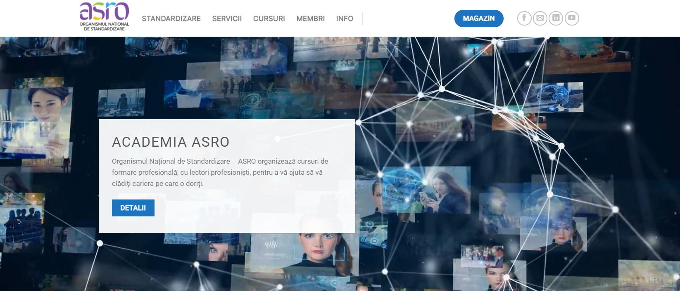




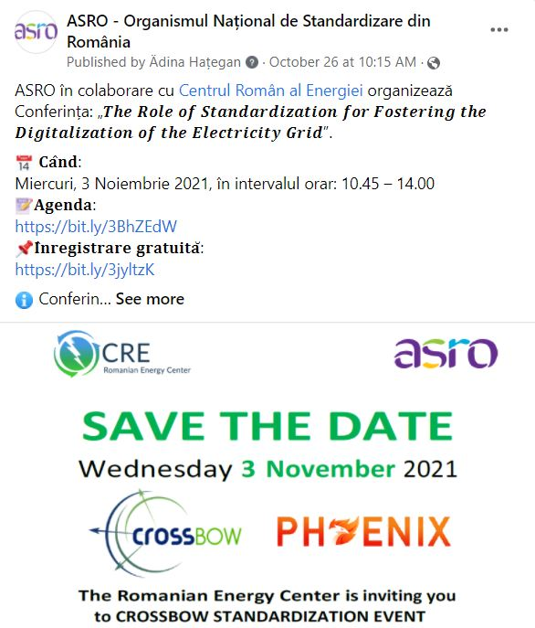
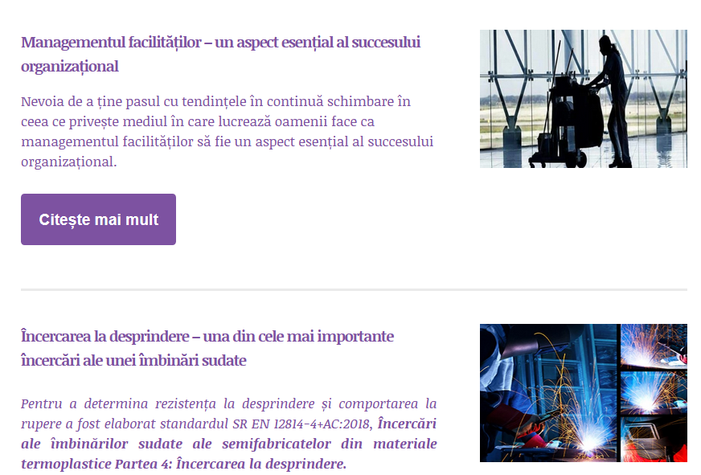
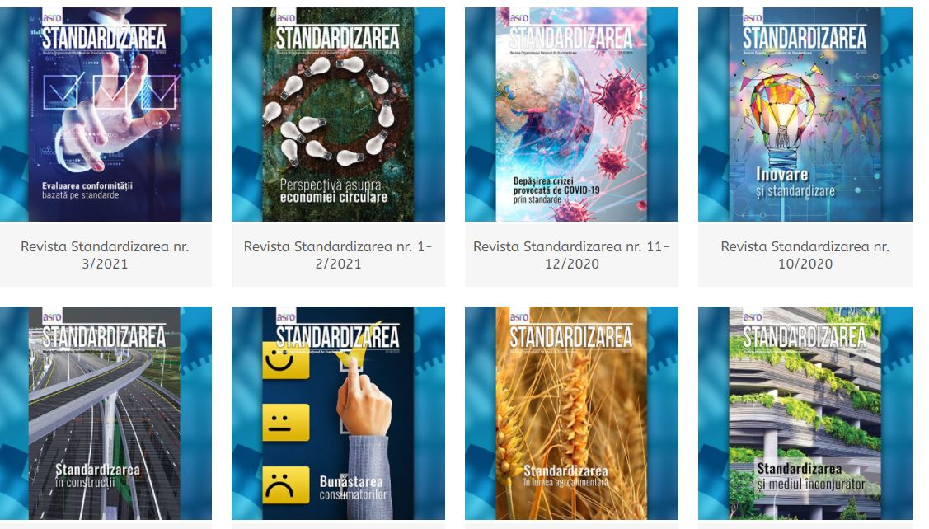
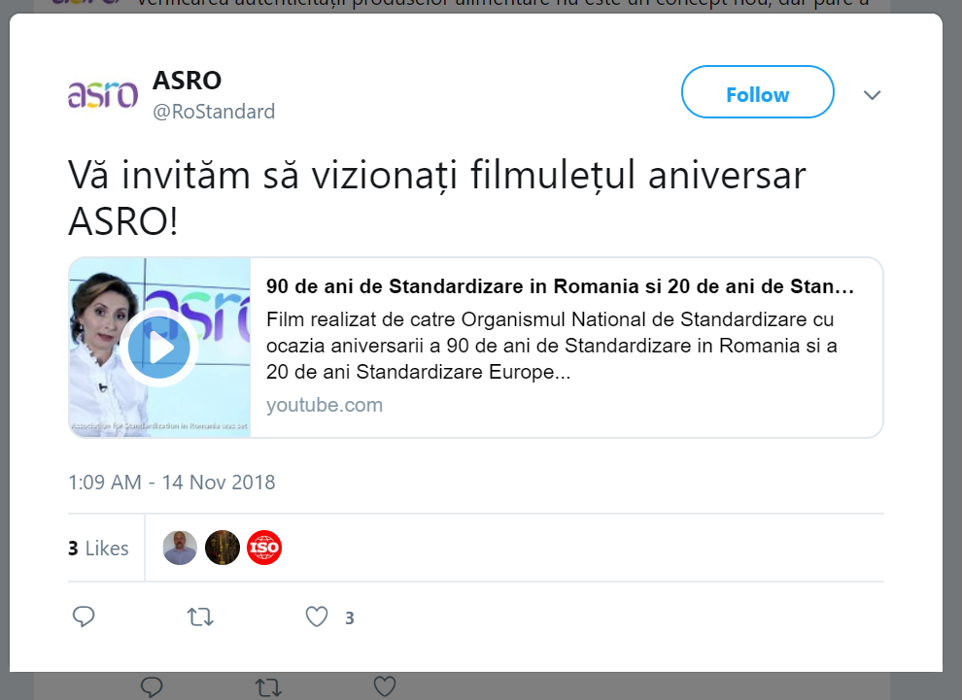
Dissemination
www.asro.ro
Events
Magazine
Notes:
ASRO could participate actively in dissemination activities too, through publication on:
its website, blog,
its social media accounts,
publication of articles in “Standardizarea” magazine and other technical magazines, in partnership with ASRO,
participation in different events at the national level organized by ASRO or in partnership: annual conference on standardization, annual fairs, participation in various events where ASRO`s experts are invited.

Slide 12
THANK YOU FOR YOUR ATTENTION!
ROMANIAN STANDARDS ASSOCIATION - ASRO
Str. Mihai Eminescu 238, Sector 2,
Bucharest, 020085, ROMANIA
asro@asro.ro proiecte@asro.ro

